Slide 1
Broadband in Coal Mines
Ben Aiken
MUSA Capstone 2022

Slide 2
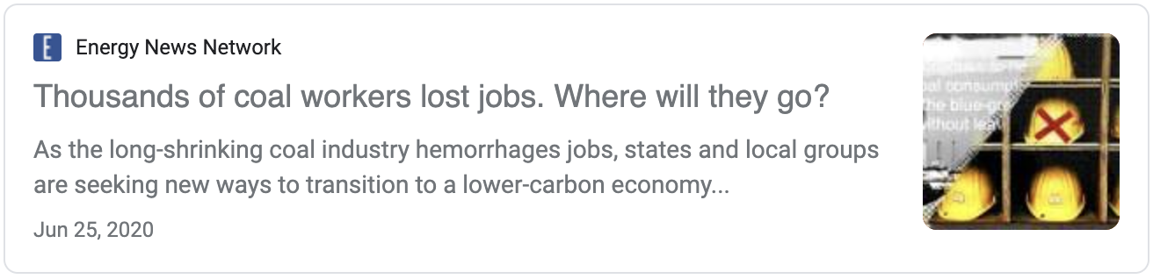
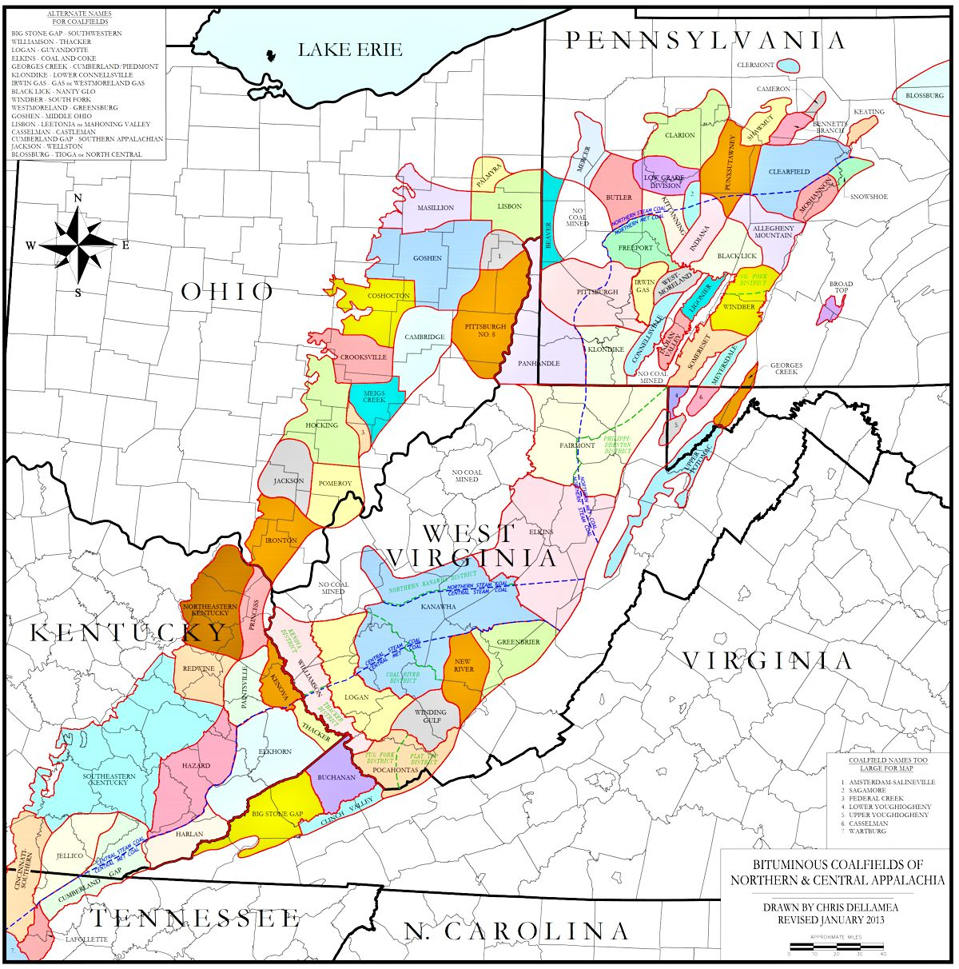
The Problem
Since 2012, 300 coal-fired power plants have closed
A win for the environment
But a loss for workers: 44,000 coal mining jobs eliminated

Slide 3
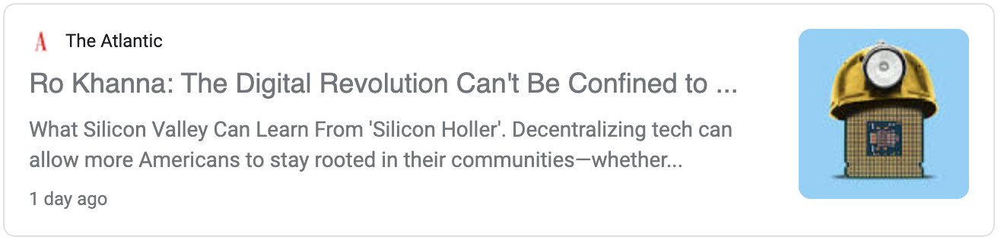

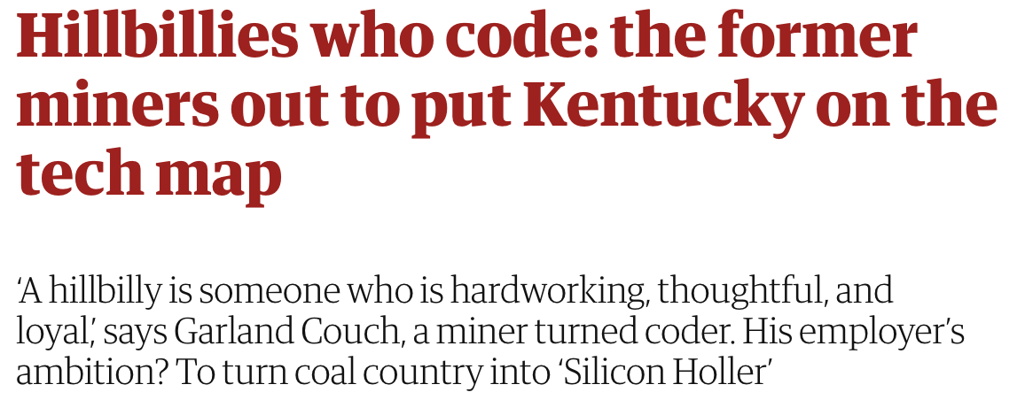
A Solution?

Slide 4
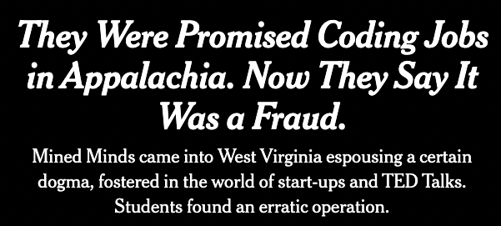
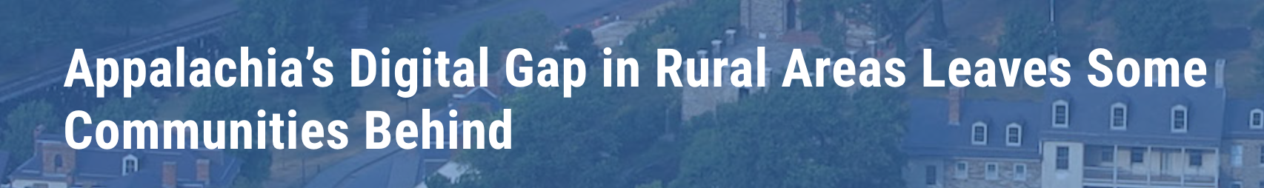
It’s Complicated
Two main criticisms arose:
Why would tech companies move to small town America
Lack of broadband in these mountainous regions
Two possible solutions:
Since the COVID-19 shutdown, remote work, especially in tech, is far more accepted
The infrastructure bill

Slide 5
The Question
$65 billion of the infrastructure bill is dedicated to expanding broadband access…
How should the infrastructure bill broadband
money be prioritized in Appalachia?
So…
Which towns in Appalachia are hit hardest by coal-mine shutdowns?
Which towns lack access to broadband?
Also, what towns have/need comp sci educational resources?

Slide 6
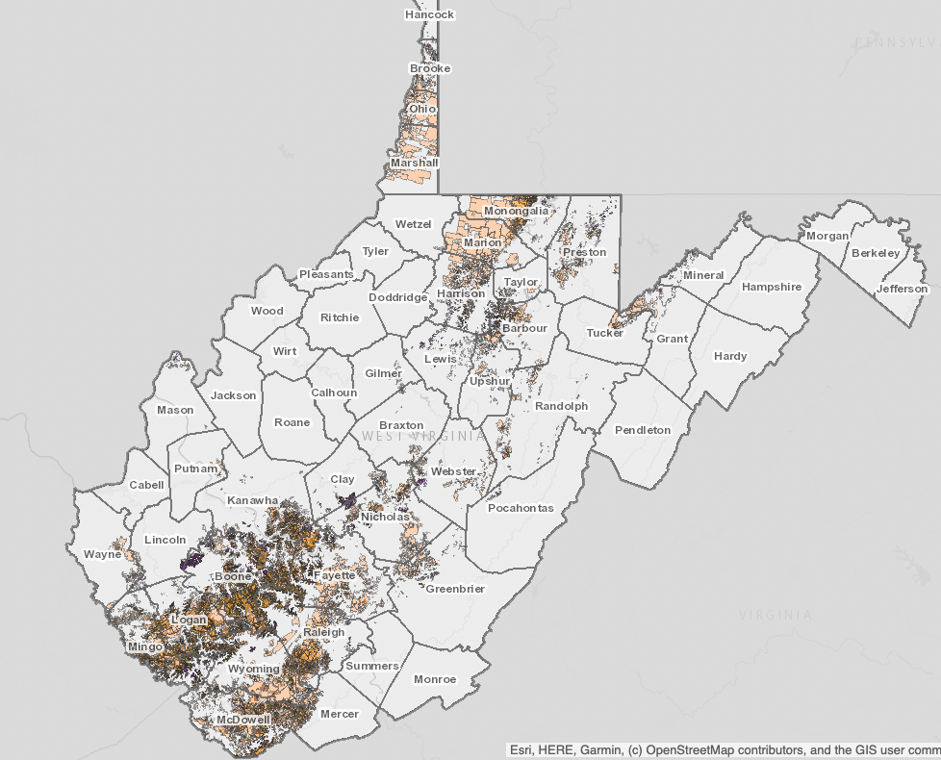
Data Sources
Coal Mine Locations, openings, and closings
PA, WV, KY Open Data
Economic & Employment Data
Census/ACS
Internet & Broadband
Census/ACS
Education
Census and other school sources

Slide 7
Next Steps
Identify descriptive statistics that clearly show the economic impact of coal mines, traced over time since the mines opened and closed
Possible ML component predicting the impact for mines that are still open – what could happen once they too eventually close?
Find computer science education data. Possibly on the state level or through non-profits like Teach For America
What other data elements would push this investigation?

